Slide 1


MainBuzz
Michael Beltz, Kolby Boone, Jackson Gordon,
Josef Hertell, Colby Money

Slide 2






Front End
Back End
Back End

Slide 3

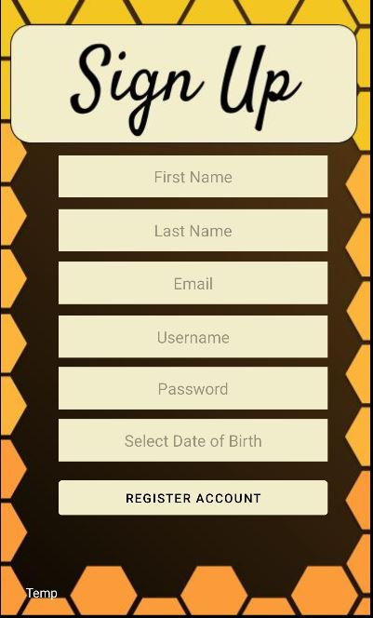

Log-In / Sign Up

Slide 4
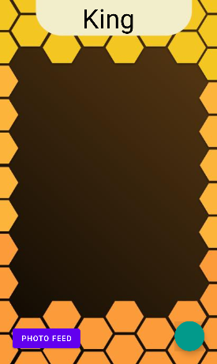

Camera Page
Prompt →
The Buzz Link →
← Camera Button

Slide 5
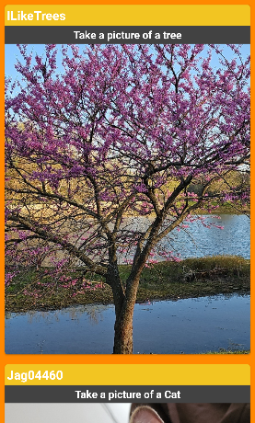

The Buzz
Username →
← Prompt
← Scrollable

Slide 6


Live Demo

Slide 7

Frequently Asked Questions (Front End)
How do I log out?
Simply closing the app will log the user out
Can the app be used on different devices?
MainBuzz is only available on Android at the moment
What security steps have been taken?
The password is hidden in the front end when entering and the backend has its own implementations

Slide 8
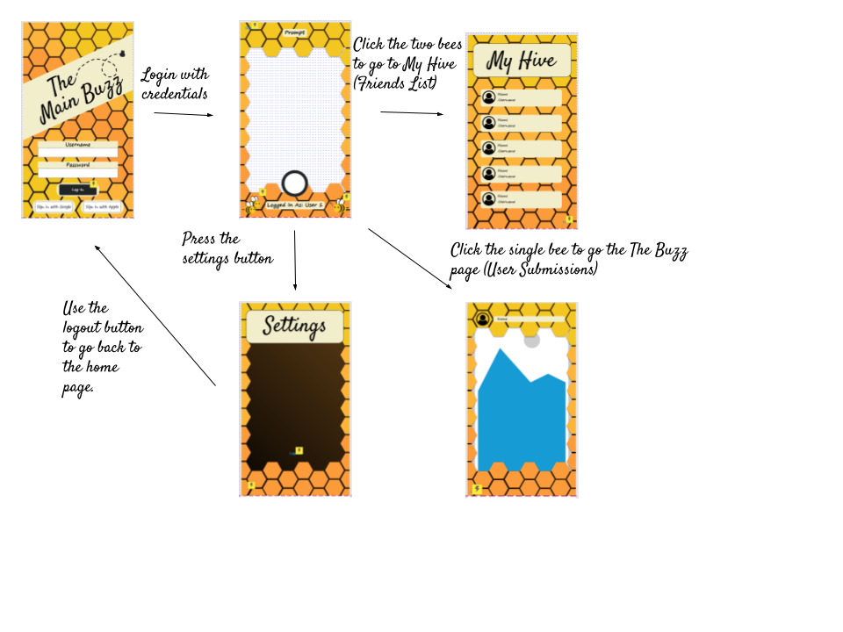

What Didn’t We Get Done?

Slide 9

Back End
Now to the code to see how the back end functions…

Slide 10

Thank You!

